Slide 1
Introduction to Normalizing Flows
Krzysztof Kolasiński, 20.09.2018

Slide 2
Content
Part 1. Introduction
Motivations for probabilistic models
Theory of Normalizing Flows + simple examples
Using Normalizing Flows in Tensorflow
Part 2. Research papers study
MADE, IAF, MAF

Slide 3
Disclaimer
possible lack of knowledge in probabilistic modeling
possible errors in the equations,
possible errors in naming stuff
sorry for random oversimplification of the notation
rare changes in notation (the Copy-Paste effect)
This is the first part, which will be more fundamental

Slide 4
Part 1. Probabilistic modeling motivations and background

Slide 5
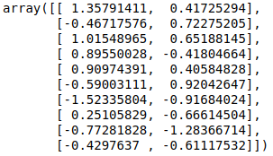
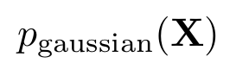
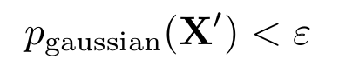
Motivation: The problem of density estimation
Consider following problem:
we observe some data X which are sample from some distribution p(X)
we want to tell what is p(X’) where X’ is some new data.
Example: anomaly detection
The simplest classical approach for this problem would be:
Take the data
Fit e.g. multivariate gaussian
Find anomalies:

Slide 6
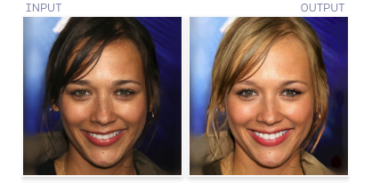
Motivation: The problem of sampling
Consider following problem:
we observe some data X which are sample from some distribution p(X)
we want to generate new data point X’ according to p(X’)
Example: dataset augmentation, latent space manipulation, generating new samples
The current state of the art approach for this problem would be to take some deep generative neural network e.g. Glow:
Example from: https://blog.openai.com/glow/

Slide 7
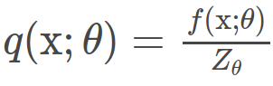
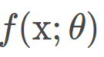
Motivation: probabilistic modeling
Probabilistic models have nice theoretical interpretation
However they are usually hard to train or they have intractable normalizing constants
Typical probabilistic model is specified as some function
where:
is some positive function parameterized with theta, usually neural network
Z is normalization constant, contains sum of f(x) over all possible configurations of x
Unfortunately:
in many cases Z is intractable, inference is impossible or require approximations
sampling may be hard, so we cannot generate samples easily
Normalizing Flows: try to overcome this problem by introducing continuous transformation of probability density which allows for tracking the change in the density p(x)

Slide 8
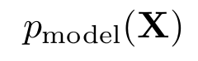
Density estimation:
maximum likelihood estimation (MLE)

Slide 9

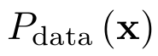
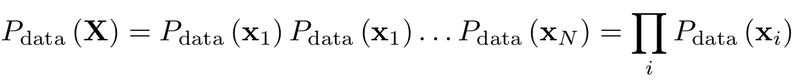
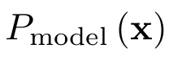
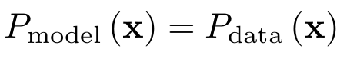
Recap: Maximum likelihood estimation
Assumptions and definitions:
probability of observing data point x (unknown):
samples drawn from p_{data} are independent (like images, CIFAR, MNIST)
we want to create a model from which we can sample:
in order to build as much “realistic” model as we can we want to have:
this allows us to define target metric which tells us how far from true distribution we are:

Slide 10
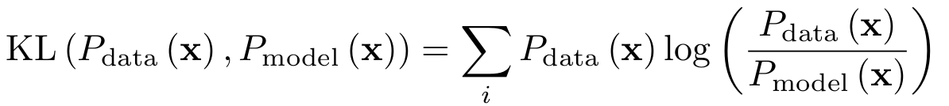
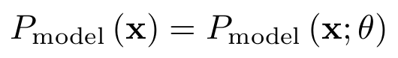
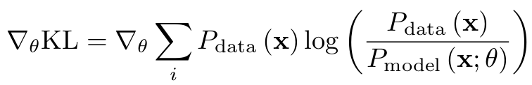
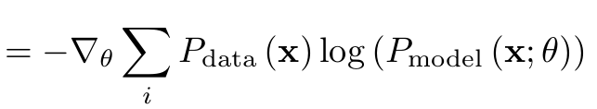
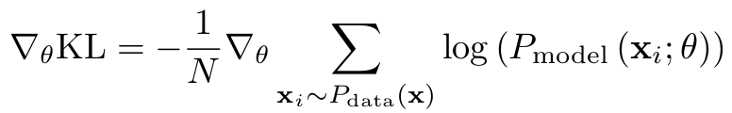
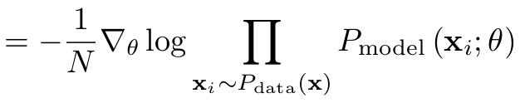
Recap: Maximum likelihood estimation
Assumptions and definitions:
The natural choice for D is Kullback Leibler divergence (this is a critical point for all derivations below):
Our generator P_{model} will be defined by some neural network, let’s put explicitly its dependence on some parameters (neural network weights)
We want to minimize KL w.r.t model parameters, hence we need to compute the gradients
The samples are explicitly sampled from data distribution (N goes to infinity):

Slide 11
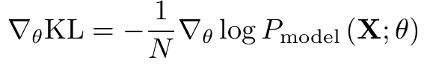
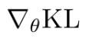
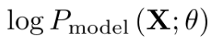
Recap: Maximum likelihood estimation
The samples are explicitly sampled from data distribution (N goes to infinity):
Recall assumption that:
This allows us to write similar expression for model (but X are drawn from “real” data)
Hence by minimizing KL divergence we maximize log-likelihood of observed data, both can be used to obtain same result. However with one it maybe do in easier way.
minimize
maximize

Slide 12
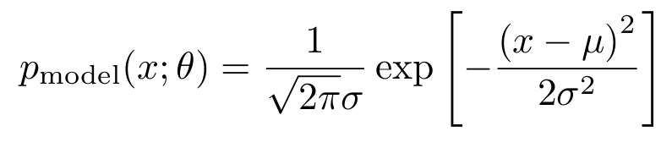
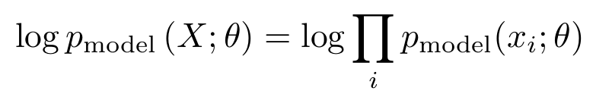
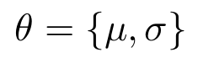
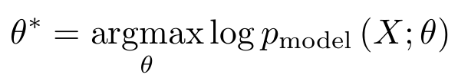
Recap: MLE for simple gaussian problem - a textbook example
Consider following problem:
we observe some data X which are sample from some distribution p(X)
we want to tell what is p(X’) where X’ is some new data.
Take the data:
Build a model:
Define likelihood function - the cost
Find the optimal model parameters by solving problem:

Slide 13
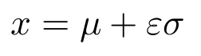
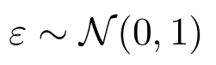
Recap: MLE for simple gaussian problem - a textbook example
Once the problem is solved we can:
estimate p_{model}(x’)
sample from p_{model} , with following sampling rule with

Slide 14
Probabilistic change of variables a.k.a Normalizing Flows

Slide 15
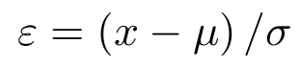
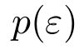
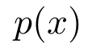
Normalizing flows - simplest case - linear transform in 1D
Normalizing Flows allow for defining complex densities by transforming simple one by invertible mappings i.e. bijections.
Let's build a simple model for the simple example considered in the previous slide.
we start from the simplest univariate gaussian distribution
we define a affine transformation (a forward pass)
and inverse (with constraint sigma > 0):
we know and we want to find

Slide 16
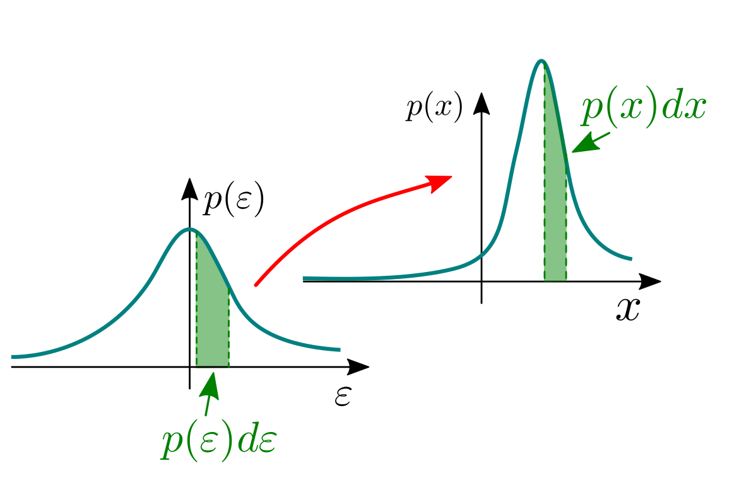
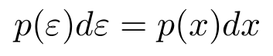
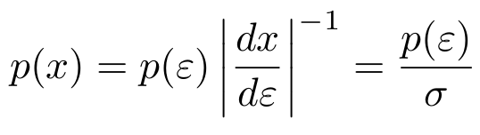
Normalizing flows - transforming scalars
The volume change, but density must be preserved:
The necessary condition for this is:
The transformed density is then:
change of volume
In order to estimate the density at x we have to apply inverse transform:
Which will result in:

Slide 17
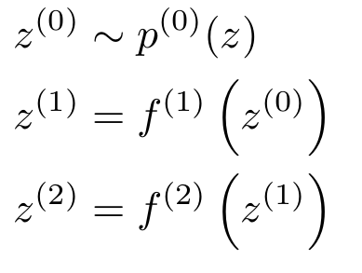
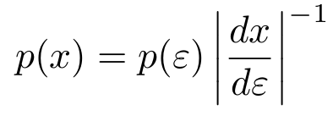
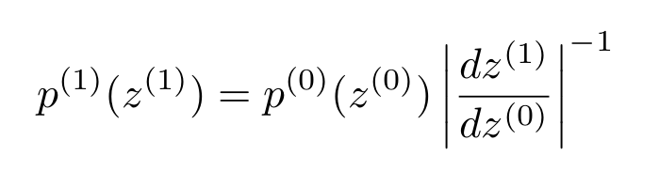
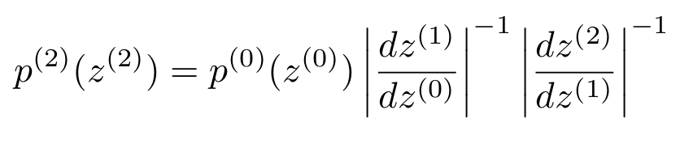
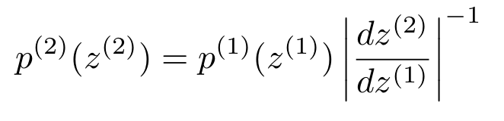
Normalizing flows - transforming scalars
Let us now consider a slightly more complicated example. Note the change of notation.
In some cases we are interested in computing a probability density of sampled data point.
This requires a forward propagation of the flow.
transformation equation
Density transformation after first map
Density of the sample:
Density transformation after second map
This is called a forward pass

Slide 18
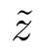
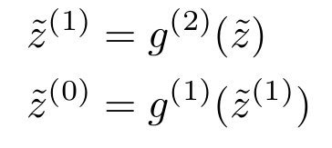
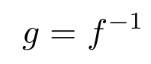
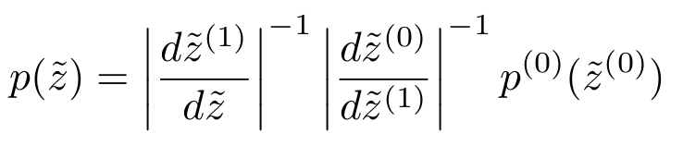
Normalizing flows - transforming scalars: inverse transform
Sampling:
Density of the sample
In other cases we are interested in estimating density of external samples. A computation of the inverse process is required.
We start with some external sample and build an inverse flow
g is an inverse map
From analogy to forward flow we can write formula for inverse flow:
Recal simple example:

Slide 19
Normalizing flows - forward and inverse flows summary
Forward flow:
Density of the sample
Used for sampling, useful in the context of Variational autoencoders.
Inverse flow:
Density of the external data point
Can be used for anomaly detection, and with MLE.

Slide 20
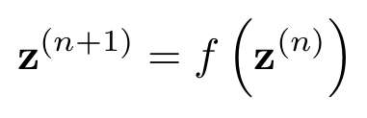
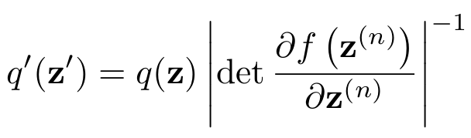
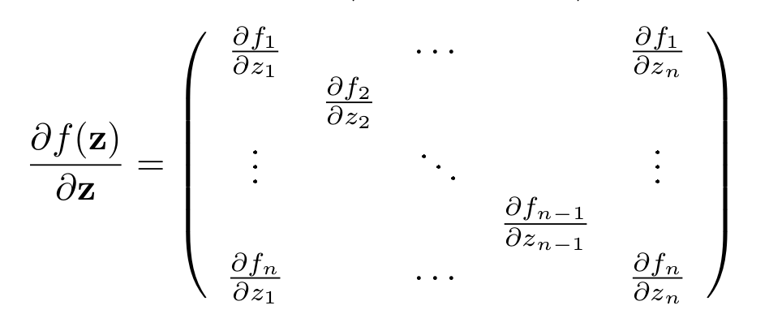
Normalizing flows - generalization
So far we worked with scalars, but NFs can be extended to multidimensional problems.
Let z be a random vector with probability density function q(z) and f(z) is an invertible function.
Transformation of the random variable leads to the following change in the probability density:
det = determinant
jacobian matrix

Slide 21
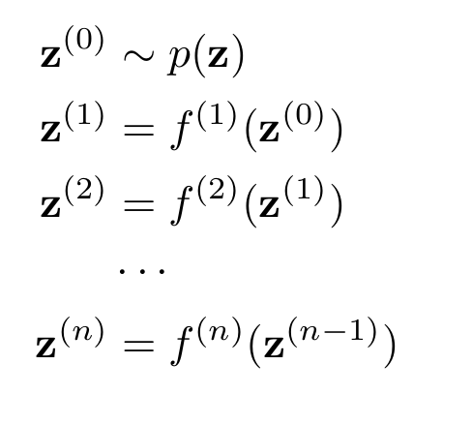
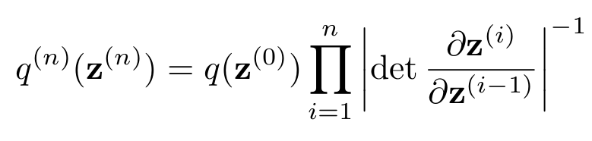
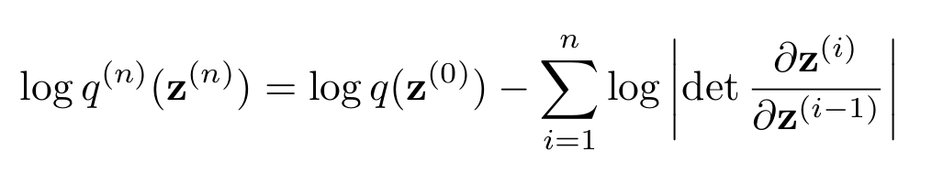
Normalizing flows - generalization
Stacking multiple mappings leads to final expression for the normalizing flow - a chain rule
density of the sampled point
Note, that in practice due to the numerical errors it is more stable to work with logarithms

Slide 22
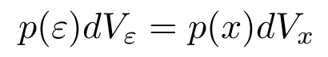
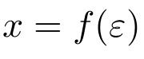
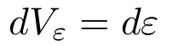

Normalizing flows - determinant
The final formula for NFs contains expression which depends on the determinant of the jacobian transformation.
Lets get some intuition how to interpret it.
Mass conservation formula:
In 1D we got:
In general we should talk about volumes, which are scalars (since we work with densities)
Source space is cartesian, so the volume is
determinant here is related to the change in the volume affected by the transformation.

Slide 23







Normalizing flows - determinant - 2D case
We are going to show the presence of the determinant on very simple 2D example, where we will show geometric interpretation of the determinant.
we want to compute this
Consider following an invertible mapping f
a vectorized expression
An infinitesimal change in the x coordinate will cause the change in the transformed space for both z₁ and z₂:
We need the field of this parallelogram
Similarly for y component:

Slide 24







Normalizing flows - determinant - 2D case
We want to compute the volume/field of the created parallelogram
We can compute the field P, using basic vector calculus:
J = Jacobian

Slide 25



Normalizing flows - determinant - 2D case
Finally want to compute:
where:
which gives:

Slide 26

Normalizing flows - determinants summary
In 1D we have a Segment
In N-D we have n-parallelotope
In 2D Parallelogram
In 3D Parallelepiped
In our case determinant can be understood as a volume of n-parallelotope spanned by the rows (or columns) of the Jacobian matrix.

Slide 27
Normalizing flows - technical details
So far we have discussed the theoretical aspects of NFs, and we got the formula for probability density flow
In most cases when people implement NFs they take into account following rules:
use log densities, since this is more stable numerically
use f such that we can compute determinant easily: diagonal or triangular matrix for which determinant can be easily computed analytically, or other not investigated options ???
use f such that computation of f(x) is easy: efficient sampling
use f such that computation of f⁻¹(y) is easy: efficient estimation of log-likelihood
use f such that we can compute derivative of it: can be used with gradient descent
use f such that computation is stable numerically
use f such that it has high expressive power usually some non linear function
Note: Various methods have been developed, but usually only part of these conditions are satisfied.

Slide 28

Normalizing flows - inference and generation
Let us recall once again difference between inference and generation
note the space distortion!
Used when we are interested in MLE:
inverse transform
inverse log det jacobian
no reconstruction loss
Used when we are interested in sampling: mostly related to VAEs
forward transform
forward log det jacobian, for estimation of density of model samples
we need to add reconstruction loss
Density estimation using Real NVP (2016)

Slide 29




Normalizing flows - case study: Variational Inference in VAEs
Variational Inference with Normalizing Flows work improves standard VAEs by introducing sampling from approximated posterior generated by NF
Standard VAE
VAE with NF
source
sampling in VAE
Standard VAE can be understand as special case of Normalizing Flows
sampling in VAE with NF
In VAEs we are interested in forward flow, so e.g. we can resign from easily invertible f

Slide 30





Normalizing flows - case study: Variational Inference in VAEs
Variational Inference with Normalizing Flows work improves standard VAEs by introducing sampling from approximated posterior generated by NF
In VAEs we are interested in forward flow, so e.g. we can resign from easily invertible f in favor of more expressive nonlinearity:
Planar flow:
A demonstration of the expressive power of NF with flow length K
h(x)=tanh(x)
Radial flow:
Note: This function cannot be easily inverted, but we just need have it as bijective function (invertibility condition). You can find more information in the paper.

Slide 31

Normalizing flows - case study: Variational Inference in VAEs
Variational Inference with Normalizing Flows work improves standard VAEs by introducing sampling from approximated posterior generated by NF
A demonstration of the expressive power of NF with flow length K
My implementation, flow with K=16
Examples in notebook: 3

Slide 32
A short break

Slide 33
Examples: Normalizing Flows in Tensorflow

Slide 34



Normalizing flows - Bijectors
Link to publication: https://arxiv.org/pdf/1711.10604.pdf
Normalizing flows in TF are realized with Bijectors and Distribution classes.
Documentation is quite good.
Bijectors are used to transform some base/simple distribution e.g. univariate Gaussian
They implement following methods:
forward - sampling
forward_log_det_jacobian - density of own sample
inverse - density estimation
inverse_log_det_jacobian - density estimation
Forward sampling:

Slide 35




Normalizing flows - Bijectors
Sample-Batch-Event shape tensors name semantics in Bijectors
Sampling from distributions
Sampling from transformed distribution

Slide 36



Normalizing flows - simple Exp Bijector
For custom Bijectors we must implement _private methods
Taken from Tensorflow documentation
Inverse function theorem
A general mathematical property

Slide 37


Normalizing flows - Chain Bijector
Bijectors can be chained with Chain Bijector.
This allows to compose complicated distributions
We can sample from them or even compute log_prob, prob values
Note: Remember to reverse your bijectors list, since the bijectors are applied from the end, as is done in mathematical equation:

Slide 38




Normalizing flows - example: estimating density
Affine scalar: mu, sigma are acts elements wise
We want to estimate the density at some point z
This can be done easily with Bijectors by calling log_prob or prob
Some people prefer manual computation:
log_prob
prob

Slide 39

Normalizing flows - tensorflow probability package
More examples at: https://github.com/tensorflow/probability/tree/master/tensorflow_probability/examples

Slide 40


Density estimation: maximum likelihood method
With NFs we can do exact MLE, since likelihood is trackable
Consider following example:
z0
z1
z2
In MLE we want to maximize (X=z2):

Slide 41




Density estimation: maximum likelihood method - demo
Let’s build probabilistic P_{model} for which we can sample and estimate logP_{model}
In real world problems we have access to z2 only
Model definition:
3. Definition of the cost function: L = -logp(z2)
4. Training:
5. Learned samples:
2. Initial samples from the model:

Slide 42





Density estimation: MLE and mixture of gaussians (not NFs)
Demo in the notebook
2. Model definition
Toy dataset:
4. Samples from trained model
3. loss function:

Slide 43
Density estimation: summary
For simple models we can just call to define cost function
loss = - tf.reduce_mean(model_dist.log_prob(x_samples))
x_samples - our data or minibatch e.g. tensor of shape [32, 2]
loss - the current value maximum likelihood we want to minimize
model_dist - some probabilistic model
For hard problems this will usually require some hacks and practice...

Slide 44
Part 2. Practical implementations of NFs with Deep Neural Networks

Slide 45
NFs with Neural Networks:
MADE: Masked Autoencoder for Distribution Estimation (2015)

Slide 46





Autoregressive models - MADE
MADE - Masked Autoencoder for Distribution Estimation
MADE is a building block of many NFs architectures, but itself is not related with NFs
People use this concept because it allows for creating functions with triangular Jacobian matrix
We start with high level description of the problem considered in MADE paper.
The authors consider autoencoder with binary cross entropy loss
This loss result from log of Bernoulli distribution assumption:
This final loss can be zero for some trivial case with q(x) = 1, hence q(x) is not a proper since:

Slide 47



Autoregressive model - MADE
In short: vanilla autoencoder with binary cross entropy loss, does not have probabilistic interpretation.
The authors want to make it a probabilistic model with trackable and normalized p(x).
They propose following solution for that:
Probabilistic chain rule
e.g. P(x, y) = P(y | x) * P(x)

Slide 48


Autoregressive model - MADE
Formally, autoencoder forms a proper distribution if each output unit d depends on units d’<d.
They call this autoregressive property, since the negative log-likelihood is equivalent to sequentially predicting (regressing) each dimension of input x
The last sentence means that the Jacobian matrix of the autoencoder is lower triangular matrix with zeros on the diagonal:
output vector of the autoencoder
input vector of the autoencoder
This property is achieved by masking weights of the autoencoder matrices

Slide 49



Autoregressive model - MADE
MADE:
Copied from A. Karpathy MADE implementation
13 lines for simple MADE implementation:

Slide 50


MADE - final remarks
MADE:
Some final remarks:
MADE allows to create a NN which Jacobian matrix will be lower triangular with zeros on diagonal
MADE makes autoencoder probabilistic model from which one can sample:
From paper
My samples 2 obtained from hidden layers model
Bad things:
Single mask works poorly, so they need to run model on ensemble of different mask to reach SOTA, i.e. slower training, slower sampling etc...
Masks do not depend on data, instead they depend on some heuristics which may make MADEs just worse

Slide 51

MADE - final final remarks
Watch out on different MADE implementations! e.g. Tensorflow implementation leads to deterministic matrices and num_blocks is not defined in the original paper and it is not documented in TF implementation.
This function is used in masked_dense function which is used by few other functions which are used to build some NF networks.
The original implementation of the mask generation has ~100 lines and it is hard to read and it is written in Theano.
Linear mask implementation from IAF paper is also different.
Autoregressive masks can be implemented for convolutional layers (check this)

Slide 52
Improved Variational Inference with Inverse Autoregressive Flow (OpenAI/2016)

Slide 53
Normalizing flows + VAE + MADE
We discuss the content of this paper: Improved Variational Inference with Inverse Autoregressive Flow
We already discussed the application of NFs to VAEs
VAE with NF
The authors of IAF argue that planar and radial flows used by (Rezende and Mohamed 2015) have limited expressive power
They propose to use MADE blocks.
Remember: In VAEs we are interested in forward flow, so e.g. we can resign from easily invertible f

Slide 54



IAF - Inverse Autoregressive Flow
The algorithm for IAF is following:
initialize the chain of transformations by taking the output of the encoder network.
compute new mean and logits with AutoregressiveNN
apply NF transformation (stable version)
aggregate log densities
Final density:
VAE loss:
reconstruction term
regularization term

Slide 55






IAF as a Normalizing Flow - Computing Jacobian
Firstly, we show the properties of the jacobian of IAF transformation:
Consider following IAF transformation (for the brevity we skip the context vector):
where: i.e. it is lower triangular matrix with zeros on diagonal. Same for mean.
Then the Jacobian of this transformation is following:
Jacobian is triangular with zeros over diagonal
diagonal elements of the Jacobian
The log det of the Jacobian is then:

Slide 56

IAF - Inverse Autoregressive Flow
Some technical remarks and tricks they used:
They reverse order of z after each IAF step - it preserves volume so it does not change jacobian
They pass context vector h between each step, since it helps.
AutoregressiveNN is a few layer Neural Network build on MADE idea.
Sampling is fast.
Batch normalization introduced too much noise and replaced with weight normalization.
ELU instead of ReLU and data-dependent initialization
Custom modified loss which blocks oversimplification by the regularization term (see appendix in paper)
They did not show image samples, which would be nice. Numbers can be tricky ...
They also build a complicated stochastic ResNet units, which suggests that the method itself is not that powerful since they need to overcomplicate the architecture to achieve good results.

Slide 57
IAF as a Normalizing Flow
Note, that NFs are invertible transformations
IAF involves blocks of NNs which are not invertible
Is IAF invertible?

Slide 58




IAF as a Normalizing Flow - Invertibility of the transformation
IAF allows us to compute z’ given z:
Now, we want to compute z from z’:
In general sigma and mu are autoregressive NNs which are not invertible.
Since sigma and mu are autoregressive we can write equation for the first element of z’ vector. Note that sigma and mu cannot depend on z0, so I wrote them as some scalars.
from which we can compute z0 as
Having z0 we can compute z1 and so on …

Slide 59


IAF as a Normalizing Flow - Invertibility of the transformation
Inverse operation is slow, and requires D updates, where D is the dimensionality of the z vector
Recall, that for sampling (forward pass we need one pass), but here for the evaluation of the density we need D passes.
In general we can write inverse flow as:
Which can be conveniently implemented using simple algorithm (written in Bijectors API):
Correction: this is true for MAF not IAF, for IAF it should be (x- shift) / sigma

Slide 60

IAF as a Normalizing Flow - my contribution
This can be further improved by noting that we not necessarily need D iterations:
This iterative algorithm can reach convergence much faster
So it is better to use adaptive dynamic loop:
In my tests this implementation was about ten times faster, but it will depend on the problem size and complexity. In some cases convergence may appear after few iterations.

Slide 61
Normalizing flows - inference and generation
Let us recall once again difference between inference and generation
note the space distortion!
Used when we are interested in MLE:
inverse transform
inverse log det jacobian
no reconstruction loss
Used when we are interested in sampling: mostly related to VAEs
forward transform
forward log det jacobian, for estimation of density of model samples
we need to add reconstruction loss
Density estimation using Real NVP (2016)

Slide 62
Normalizing flows - inference and generation
Let us recall once again difference between inference and generation
note the space distortion!
inv(IAF) = MAF
Density estimation
IAF
Sampling in VAE
Density estimation using Real NVP (2016)

Slide 63
Masked Autoregressive Flow for Density Estimation (Edinburgh/2017)

Slide 64



MAF: Basic idea
Paper: Masked Autoregressive Flow for Density Estimation
MAF is implemented as Bijector:
IAF is an inverse of MAF:

Slide 65

MAF: Validating your model
The model quality can be easily validated by projecting input images into random variables, they should follow the gaussian distribution

Slide 66
Summary

Slide 67
Content (in past tense)
Part 1. Introduction
Motivations for probabilistic models
Theory of Normalizing Flows + simple examples
Using Normalizing Flows in Tensorflow
Part 2. Research papers study
MADE, IAF, MAF - require tricks, hacks and practice to train model

Slide 68
Content (in past tense)
Next time:
Papers: NICE, RealNVP, Glow

Slide 69
Questions?

Slide 70
Introduction to Normalizing Flows
Krzysztof Kolasiński

Slide 71
References:
http://www.machinelearning.ru/wiki/images/f/f2/LebedevTuzovaVaeNfSlides.pdf - slides about Variational Auto-Encoder & Normalizing Flows
https://docs.pymc.io/notebooks/normalizing_flows_overview.html - PyMC overview on NFs
https://github.com/ex4sperans/variational-inference-with-normalizing-flows - some reimplementation of Reimplementation of Variational Inference with Normalizing Flows Paper
https://arxiv.org/pdf/1711.10604.pdf - TensorFlow Distributions documentation
http://bjlkeng.github.io/posts/autoregressive-autoencoders/ - BLOG: very well written, with implementations and notebooks
http://ruishu.io/2018/05/19/change-of-variables/ - BLOG: CHANGE OF VARIABLES: A PRECURSOR TO NORMALIZING FLOW
http://akosiorek.github.io/ml/2018/04/03/norm_flows.html - BLOG: Normalizing Flows
https://tonghehehe.com/blog/2017/1/1/vae - Posterior Approximation for Variational Inference
https://blog.openai.com/glow/ - GLOW official website
https://towardsdatascience.com/autoregressive-models-in-tensorflow-96d69434cad9 - Blog: Autoregressive Models in TensorFlow

Slide 72
References:
http://ruishu.io/2018/03/14/vae/ - Blog: DENSITY ESTIMATION: VARIATIONAL AUTOENCODERS
https://vimeo.com/252105837 - Masked Autoregressive Flow for Density Estimation
https://arxiv.org/pdf/1705.07057.pdf - MAF
https://arxiv.org/pdf/1502.03509.pdf - MADE
https://arxiv.org/pdf/1606.04934.pdf - IAF
https://arxiv.org/pdf/1505.05770.pdf - Variational Inference with NFs
https://arxiv.org/pdf/1808.04730.pdf - some recent paper

Slide 73


